Slide 1


HEP Weekly Report
George Bakas
NTUA

Slide 2
Progress Report
DCS
CMSfwAlertSystem
Last bug fixes
DCS FSM main panel at Shifter’s screen
FSM at P5 is operated by the shifter
Shifter’s credentials are read from a Card Reader
Sometimes shifters do not place their card correctly→ several emails that the FSM has no owner etc
Goal is to build a panel instructing the shifters how to correctly place their card
ArdEnvino
Started designing the box
Analysis
Validation plots of the spin correlation and non spin correlation sample
Check to see that there is nothing odd in the plots so they can proceed and request a sample

Slide 3
Reco/Parton Distributions
Created a new production using MC 2016 (nominal MC that was used also in the top analysis but I added my lines in the analyze section to get full information about the ttbar decay products in parton level)
Now the new file has both Reco variables but also the parton variables I needed
With two separate files I had different number of events → could not do particle matching for top
Top Matching:
First in each event, check all the jets, and get only the ones that pass the selection cuts
Then go to parton level→ identify a top (particleId) and then check if it is in boosted region (Pt > 400GeV).
If yes then find min(dR) of all the selected reco jets and if this is lower than a given threshold (here 0.4) match it as top

Slide 4
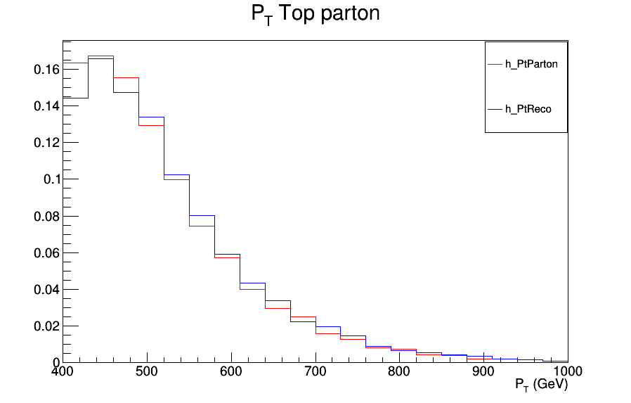
Matched top distributions
Matched Top P_{T} distribution for reco and parton

Slide 5
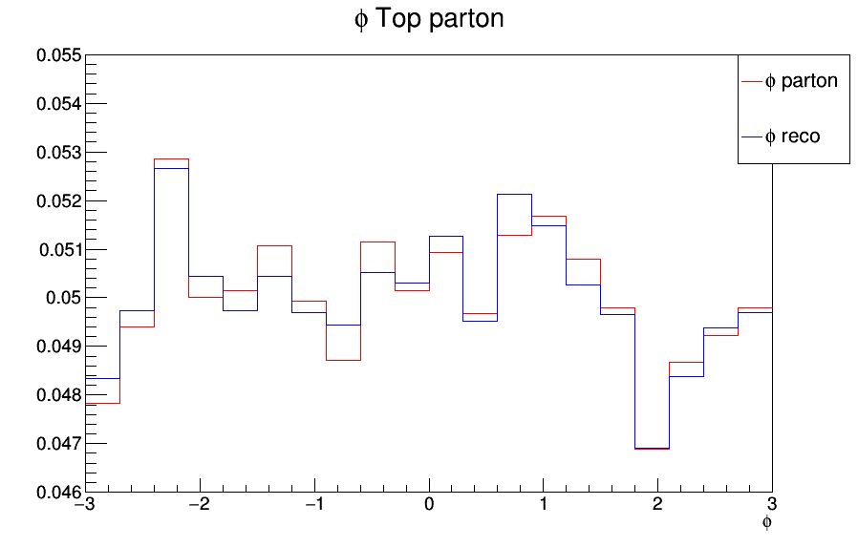
Matched top distributions
Matched Top φ distribution for reco and parton

Slide 6
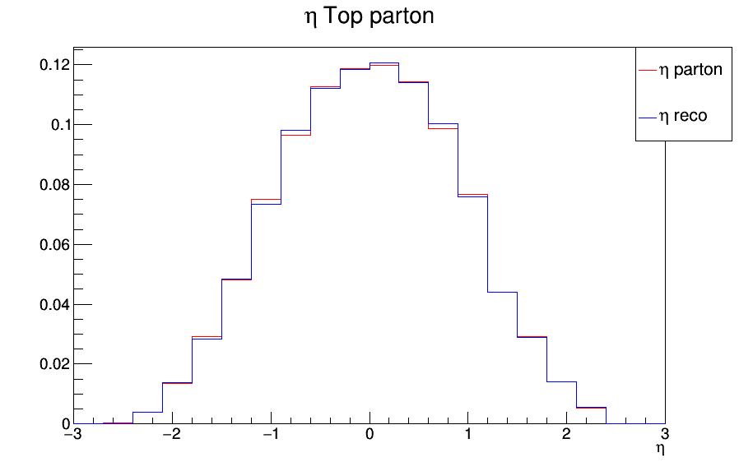
Matched top distributions
Matched Top η distribution for reco and parton

Slide 7
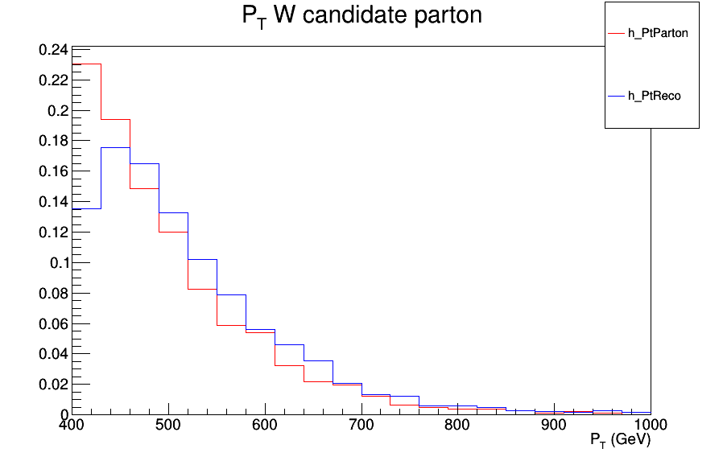
W Candidate Distributions
From the matched top events I identified W parton (with particle Id)
For every identified W boosted parton: Applied W candidate cuts
W candidate P_{T} distribution for reco and parton

Slide 8
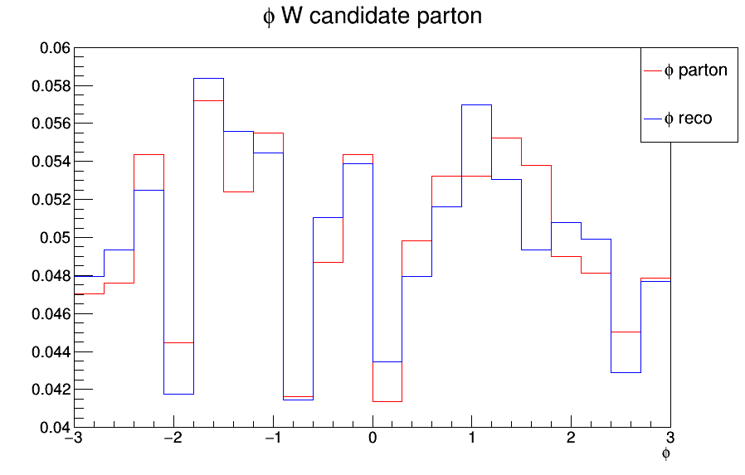
W Candidate distributions
W candidate φ distribution for reco and parton

Slide 9
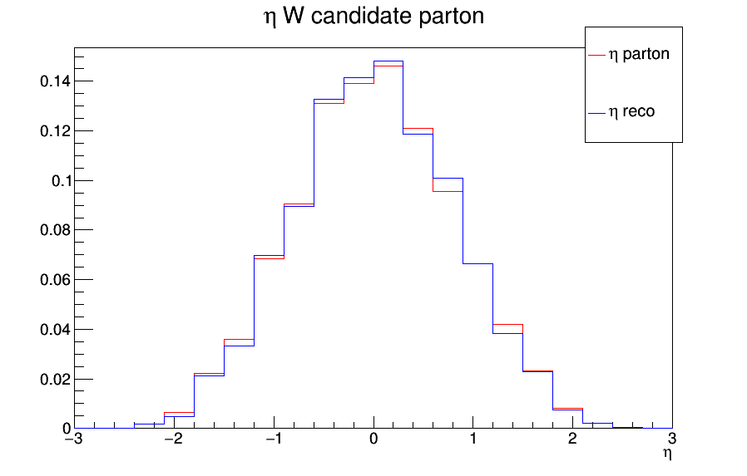
W Candidate distributions
W candidate η distribution for reco and parton

